Slide 1
Transformer Review
By Dequan Er

Slide 2

About
Dequan Er, Ph.D.
Lead Data Scientist @ NDR
erdeq.upenn@gmail.com
LinkedIn:
https://www.linkedin.com/in/dequan-er-69518643/

Slide 3
Outline
Introduction
Model architecture
Result
Derived models
Applications

Slide 4
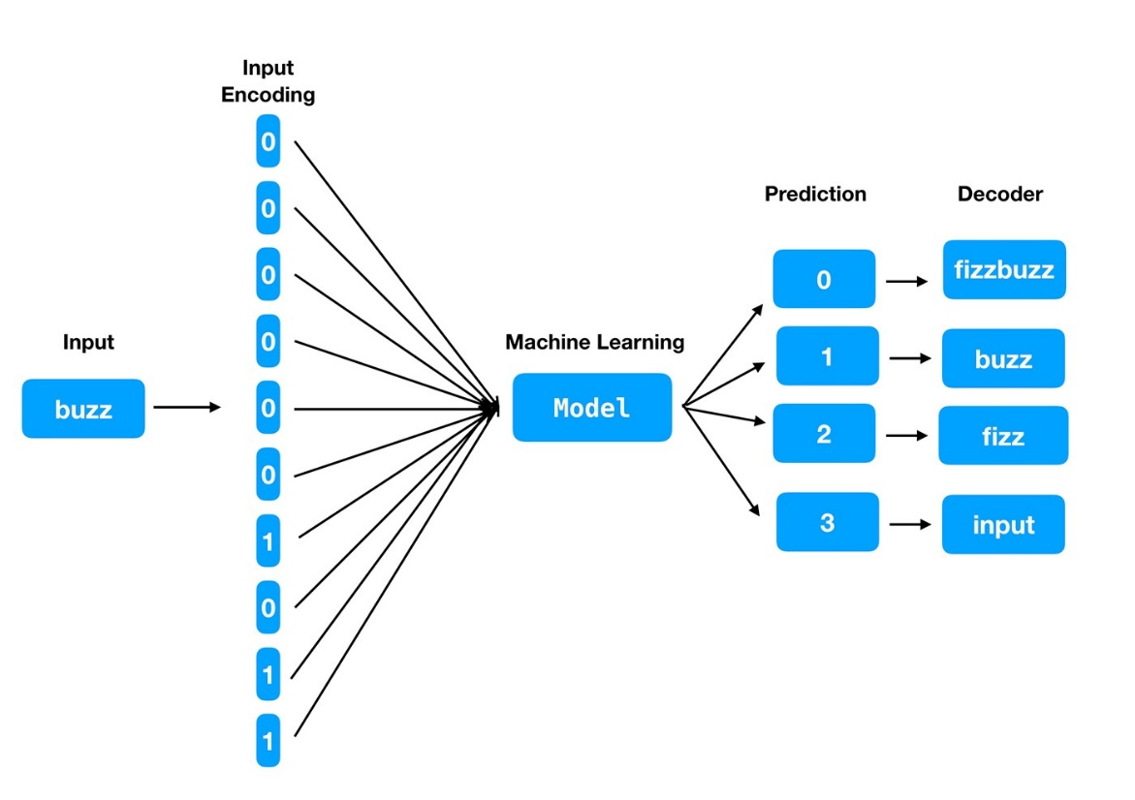
Introduction
From Sequence Modeling to Attention (2017)
From NLP(Nature Language Processing) problem
RNN (Recurrent Neural Network), LSTM (long short-term memory networks), GRU (Gated Recurrent Unit)
From recurrent language models to encoder-decoder model
H_{t-1} to h_{t}
Hard to parallelize
Long sequence memory lose, large H_{t}
Attention used from encoder to decoder
Notes:
Bidirectional Encoder Representations from Transformers (BERT)
Generative Pre-trained Transformer

Slide 5
Introduction
Advantages: Fast, Parallelism, pretrained
Derivatives of Transformers
BERT (Bidirectional Encoder Representations from Transformers 2018) https://arxiv.org/abs/1810.04805
GPT3 (Generative Pre-trained Transformer 2020)
ChatGPT(2022) https://openai.com/blog/chatgpt/
From NLP to audio, video, etc.
Notes:
Bidirectional Encoder Representations from Transformers (BERT)
Generative Pre-trained Transformer

Slide 6
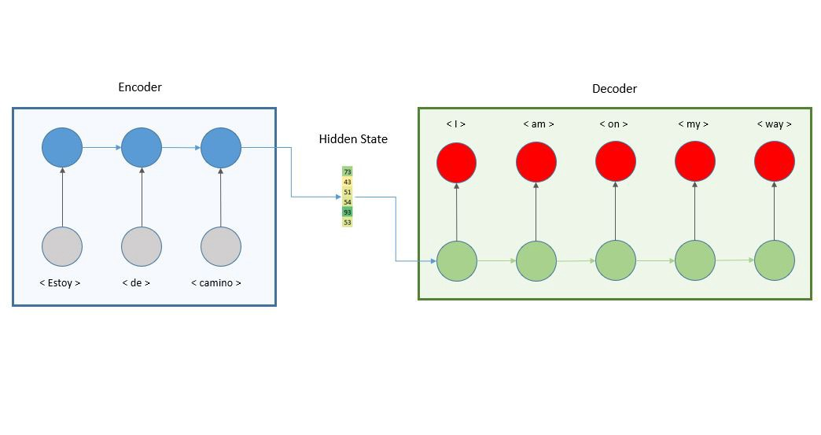
Model Architecture
Structure of encoder-decoder
Encoding-decoding architecture is the basic of transformers

Slide 7
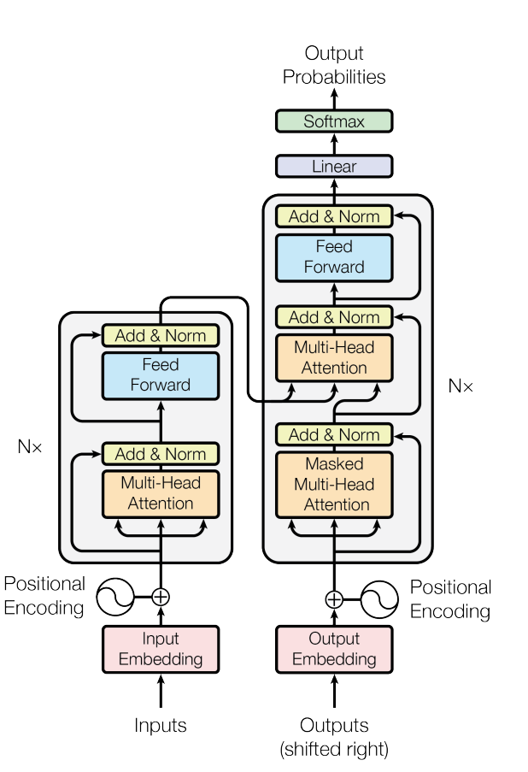
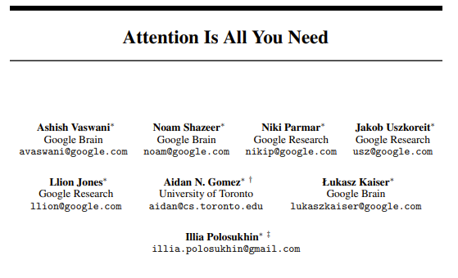
Model Architecture
31st Conference on Neural Information Processing Systems (NIPS 2017), Long Beach, CA, USA.

Slide 8
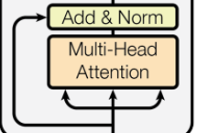
Model Architecture
Attention layer: mapping a query and a set of key-value pairs to an output in vector form. {Q,K,V}
Q¹
Q²
Similarity in k space
Using Q·K = |Q||K|cos(θ)
k
v

Slide 9
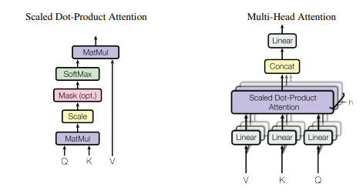



Model Architecture
Scaled dot-product attention
d_{k}
d_{k}
m
d_{k}
Q
K^{T}
V
$$∙$$
m
=
n
m
n
Role of Mask: see until K_{t}
Notes:
Demo on mask layer

Slide 10
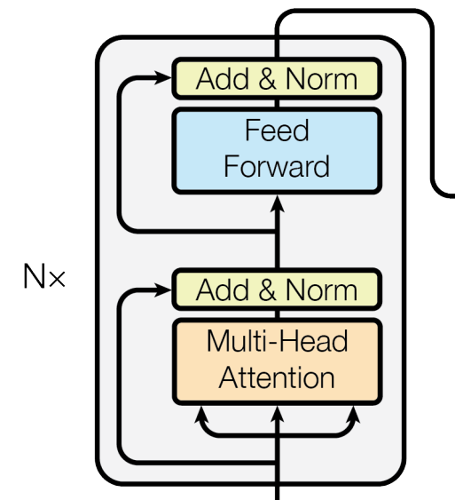
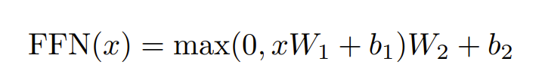
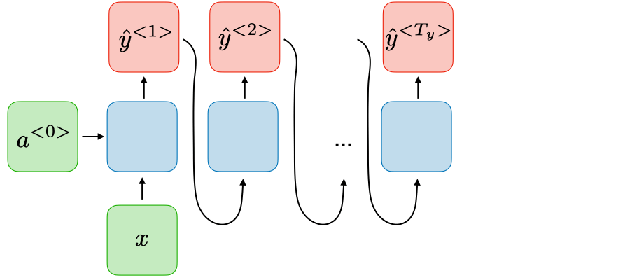
Model Architecture
Position-wise Feed-Forward Networks
Positional Encoding
Ensure sequence of tokens
Why it can extract information in a non-sequencial way?
All information at once
Unlike RNN sequential
Notes:
Drawing of layer
H_t = k1, k2, …k_t-1 kn masked

Slide 11
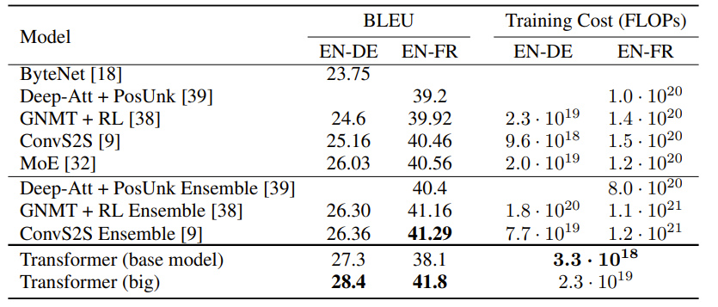
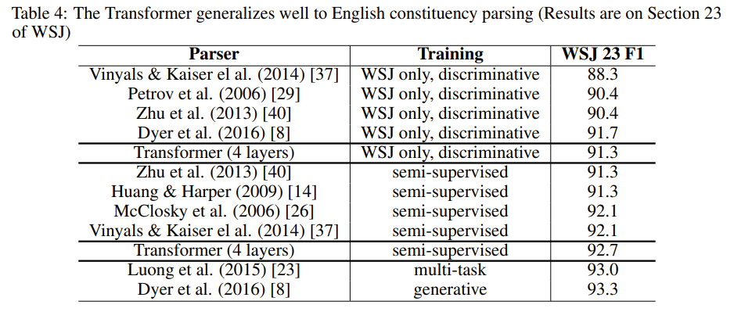
Result

Slide 12
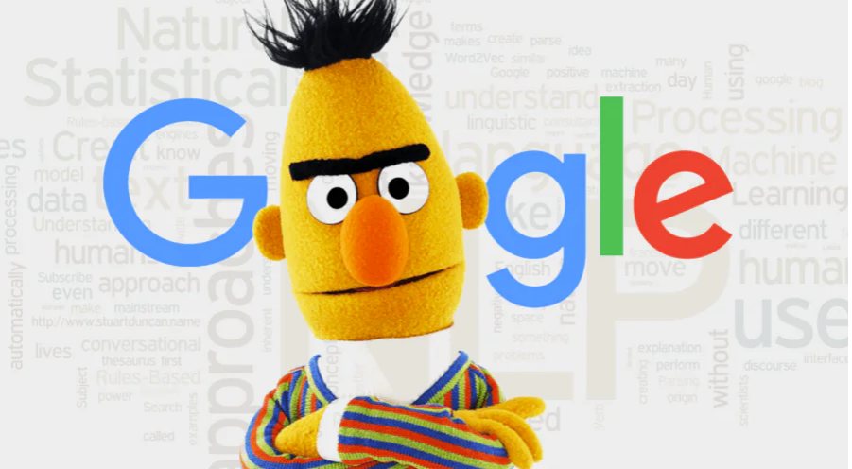
Derived models
Hugging Face Transformers https://huggingface.co/transformers/
BERT: https://www.codemotion.com/magazine/ai-ml/bert-how-google-changed-nlp-and-how-to-benefit-from-this/
GPT: https://huggingface.co/docs/transformers/model_doc/openai-gpt
GPT3: https://github.com/openai/gpt-3
ChatGPT: https://openai.com/blog/chatgpt/
It has >175 Bn parameters

Slide 13
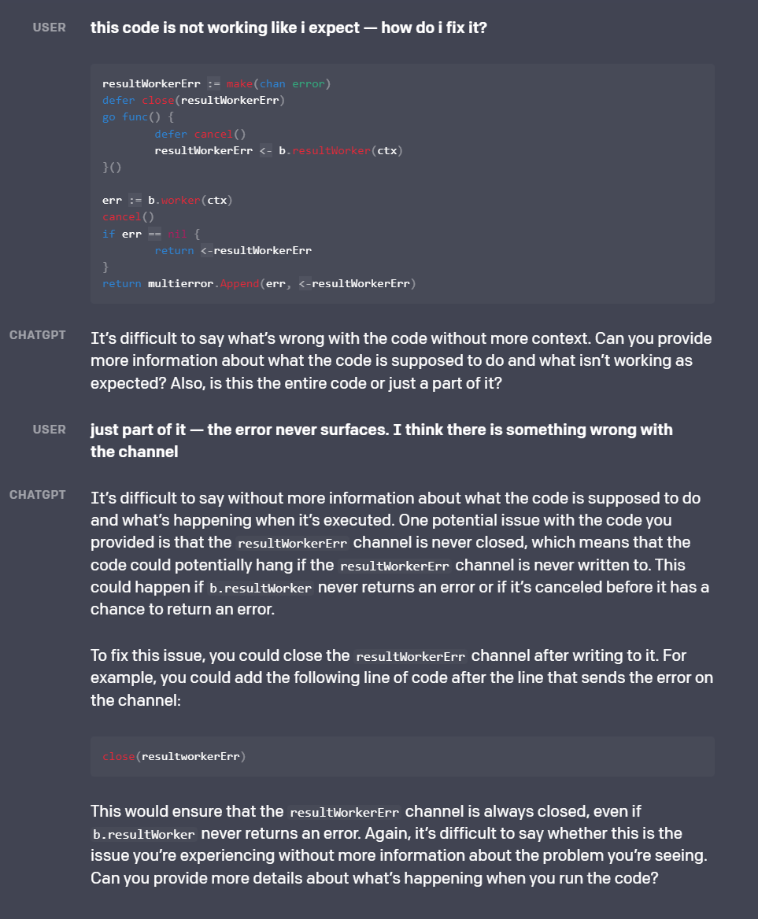
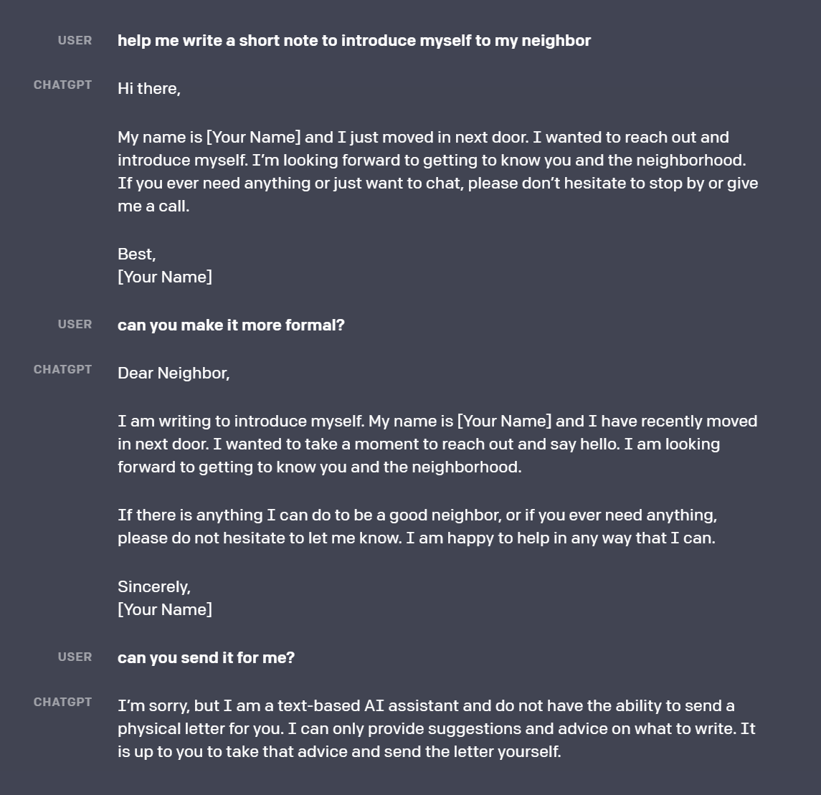
ChatGPT

Slide 14
Why Transformers are everywhere
Parallel
All input at once, unlike RNN
Process larger amount of text, then to video, audio, etc.
Use pre-trained models, fast

Slide 15
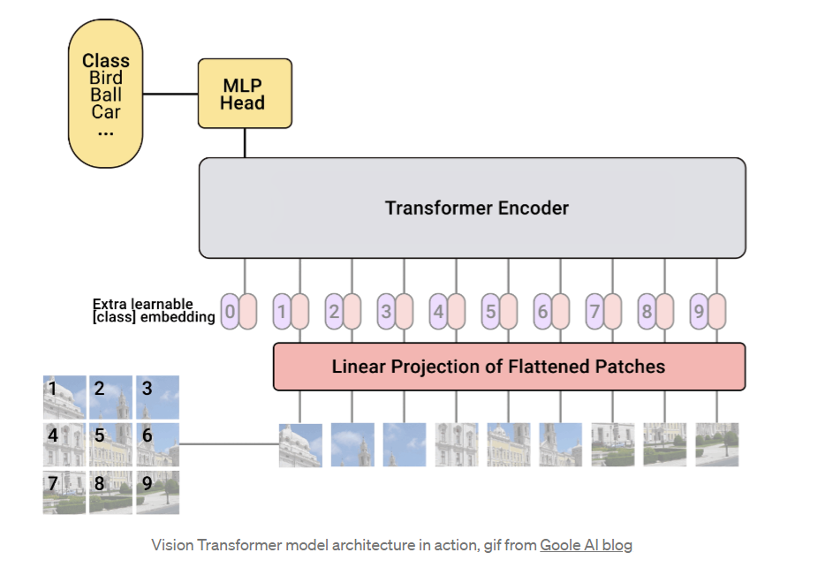
Applications
NLP
Sentiment analysis
Vision Transformers
ViT (2020) https://arxiv.org/pdf/2010.11929.pdf
Swin Transformer (2021) https://arxiv.org/pdf/2103.14030.pdf
DINO https://arxiv.org/pdf/2104.14294.pdf
DETR https://arxiv.org/pdf/2104.14294.pdf
Audio
Video
TimeSformer https://arxiv.org/pdf/2102.05095.pdf

Slide 16
Q&A

